Slide 1
SOFTWARE PROCESS MODELS
WHEN TO USE??

Slide 2
When to use the Waterfall Model
Requirements are very well known
Product definition is stable
Technology is understood
New version of an existing product
Porting an existing product to a new platform.

Slide 3
When to use Structured Evolutionary Prototyping
Requirements are unstable or have to be clarified
As the requirements clarification stage of a waterfall model
Develop user interfaces
Short-lived demonstrations
New, original development
With the analysis and design portions of object-oriented development.

Slide 4
When to use RAD
Reasonably well-known requirements
User involved throughout the life cycle
Project can be time-boxed
Functionality delivered in increments
High performance not required
Low technical risks
System can be modularized

Slide 5
When to use the Incremental Model
Risk, funding, schedule, program complexity, or need for early realization of benefits.
Most of the requirements are known up-front but are expected to evolve over time
A need to get basic functionality to the market early
On projects which have lengthy development schedules
On a project with new technology

Slide 6
When to use Spiral Model
When creation of a prototype is appropriate
When costs and risk evaluation is important
For medium to high-risk projects
Long-term project commitment unwise because of potential changes to economic priorities
Users are unsure of their needs
Requirements are complex
New product line
Significant changes are expected (research and exploration)

Slide 7
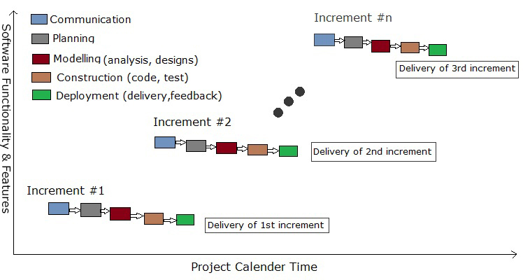
The Incremental Model
Incremental Model

Slide 8
Description
Incremental model in software engineering is a one which combines the elements of waterfall model which are then applied in an iterative manner.
It basically delivers a series of releases called increments which provide progressively more functionality for the client as each increment is delivered.

Slide 9
In incremental model of software engineering waterfall model is repeatedly applied in each increment. The incremental model applies linear sequences in a required pattern as calendar time passes. Each linear sequence produces an increment in the work.
Advantages Of Incremental Model
Initial product delivery is faster.
Lower initial delivery cost.
Core product is developed first i.e main functionality is added in the first increment.
After each iteration, regression testing should be conducted. During this testing, faulty elements of the software can be quickly identified because few changes are made within any single iteration.
It is generally easier to test and debug than other methods of software development because relatively smaller changes are made during each iteration. This allows for more targeted and rigorous testing of each element within the overall product.
With each release a new feature is added to the product.
Customer can respond to feature and review the product.
Risk of changing requirement is reduced
Work load is less.

Slide 10
Disadvantages Of Incremental Model
Requires good analysis.
Resulting cost may exceed the cost of the organization.
Each phase of an iteration is rigid and do not overlap each other.
As additional functionality is added to the product, problems may arise related to system architecture which were not evident in earlier prototypes.

Slide 11
The objective of evolutionary prototyping is to deliver a working system to end-users
The development starts with those requirements which are best understood.
The objective of throw-away prototyping is to validate or derive the system requirements
The prototyping process starts with those requirements which are poorly understood.

Slide 12
Throw-away Prototyping

Slide 13
Throw-away Prototypes
Used to reduce requirements risk
The prototype is developed from an initial specification, delivered for experiment then discarded
The throw-away prototype must NOT be considered as a final system
Some system characteristics may have been left out
There is no specification for long-term maintenance
The system will be poorly structured and difficult to maintain

Slide 14
Evolutionary Prototyping
Must be used for systems where the requirements specification cannot be developed in advance
Based on techniques which allow rapid system iterations
Verification is impossible as there is no specification
Validation means demonstrating the adequacy of the system

Slide 15
Evolutionary Prototyping Flow

